Slide 1
Merchant Onboarding
Guide

Slide 2
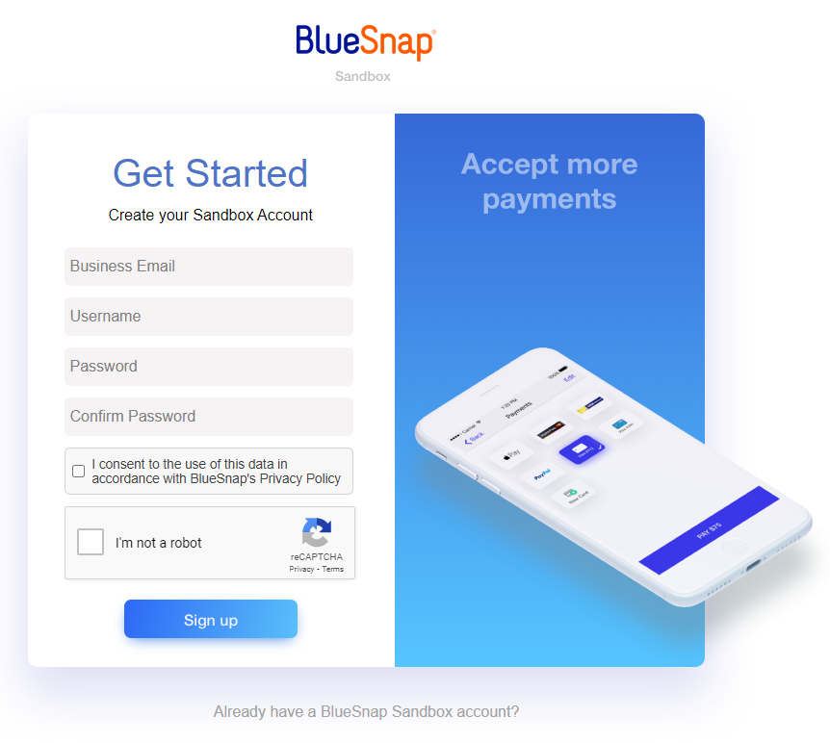
Step 1: Getting Started
Onboarding URLs:
Standard ACH ($15 - 3 day std approval)
· https://sandbox.bluesnap.com/jsp/referred_onboarding/?referral=RAPIDWORK1
Expedited ACH ($25 - 1 day approval)
· https://sandbox.bluesnap.com/jsp/referred_onboarding/?referral=RAPIDWORK2
Needs to be a business email.
@gmail, @yahoo, etc. will not work
User can customize their username and password.

Slide 3
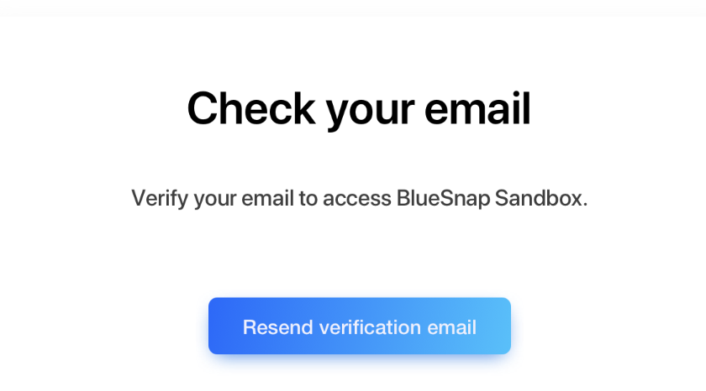
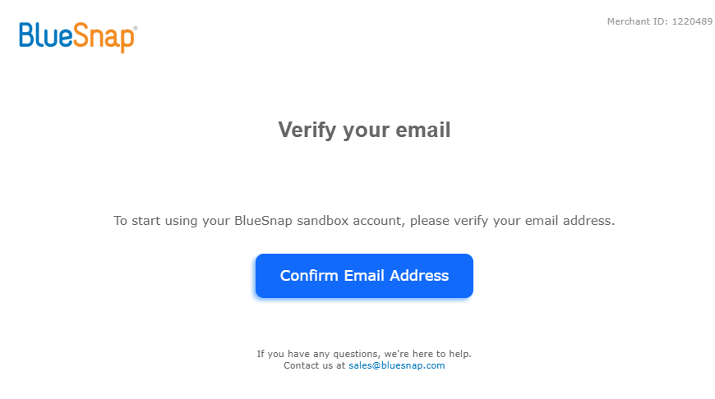
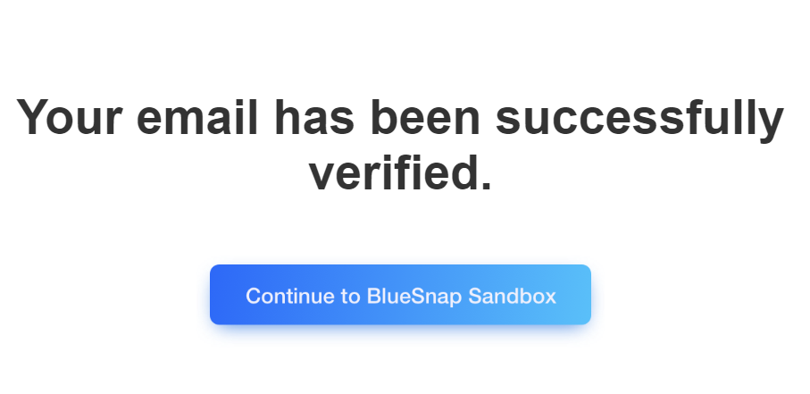
Step 2: Verify Your Email
Merchants will need to click on the email from do-not-reply@bluesnap.com to verify their email address entered in Step 1.

Slide 4
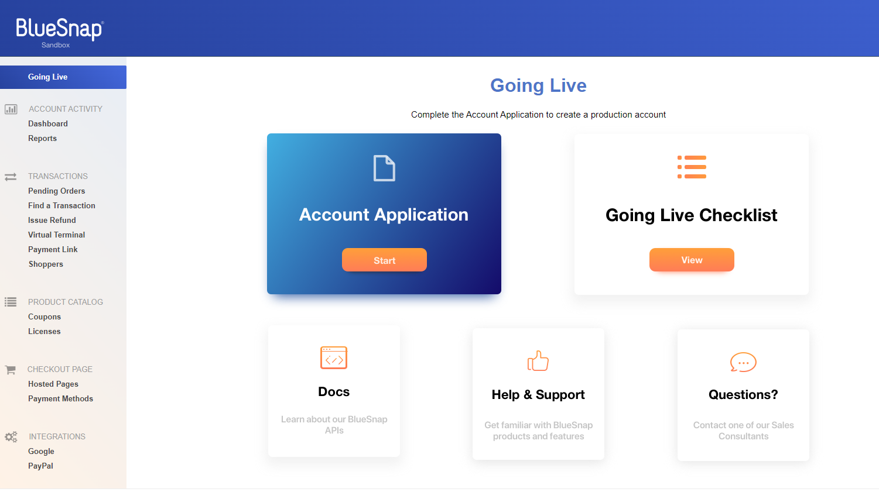
Step 3: Start Application
After you have successfully verified your email, you will see a welcome screen that says, “Start Exploring.”
You will click on “Start Exploring,” then immediately click on “Start Application” under “Going Live”.
Click to start Application

Slide 5
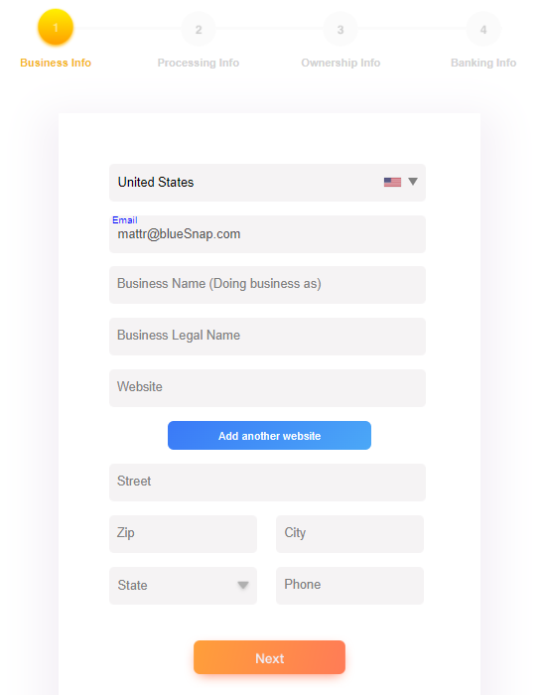
Step 4: Business Information
Need Business name (DBA) and the full Legal Name
Business Address

Slide 6
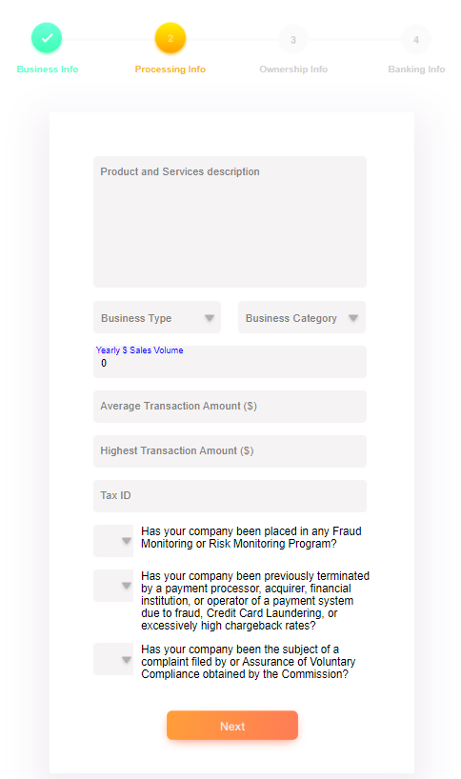
Step 5: Processing Information
The second section is collecting information on transaction behaviors and the purpose for the merchant account.
These questions help establish processing behavior expectations to better assist BlueSnap in protecting the merchant’s business. These also help BlueSnap in ensuring that the business is registered properly for tax reporting and regulatory purposes.
Annual volume expected through BlueSnap (Estimate is fine)
Highest Expected transaction size (even if outlier to normal business)
Yes or no – Company should know if any of these apply

Slide 7
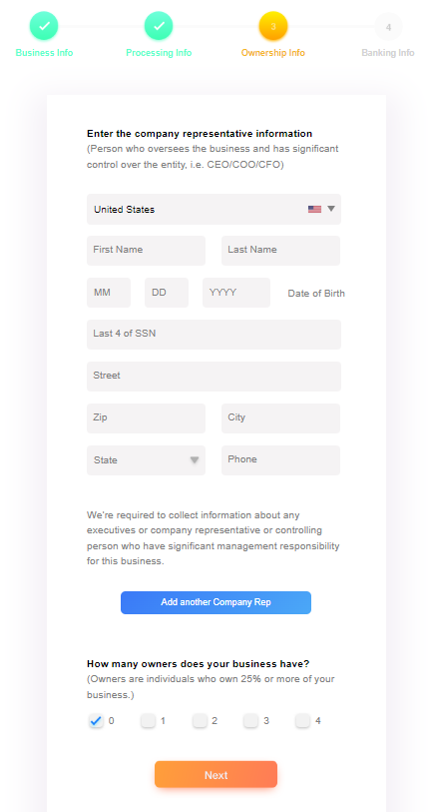
Step 6: Ownership Information
Anyone that has 25% or more beneficial ownership of the business must supply their personal information per regulatory requirements
The address must be the beneficial owner’s residential address.
Soft credit pull is done on the company representative to validate.
Required for any person with 25% or more owndership

Slide 8
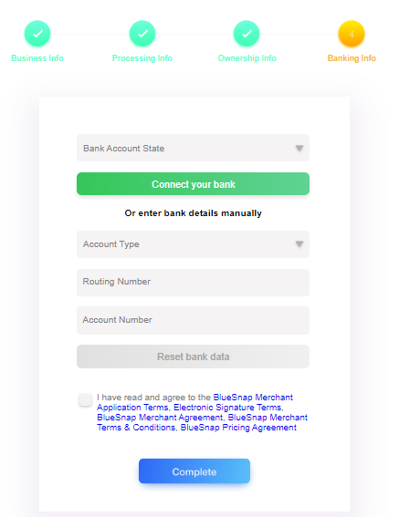
Step 7: Banking Information
The last step is to supply the banking information where you will receive your payout deposits.
Then, you will click to accept the merchant application T&C, Signature Terms, Merchant Agreement, and Pricing.
Last, you will click Complete to submit your merchant application.
After you complete your merchant application, you can logout of the sandbox portal. You do not need to access this portal again
Finalize and submit the application

